Slide 1
Building Resilient Families through Pediatric Practice
Ariane Marie-Mitchell, MD, PhD, MPH
9/30/22

Slide 2
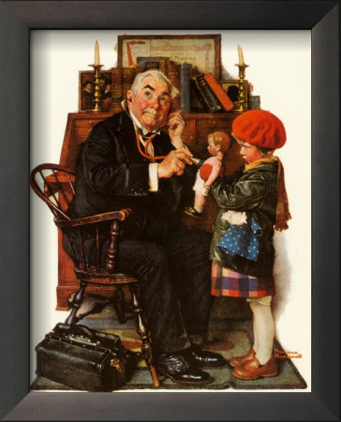
My Call to Action
Notes:
Need for tailored well-child care
3 opportunities for prevention – there must be something we can do

Slide 3
OUTLINE
What do we know about the science of ACEs and Resilience?
What do we need to know in order to translate that science into clinical practice?
Given what we know and don’t know today, what can pediatricians do to build family resilience?
Notes:
Start off by telling you about a patient case that makes me very angry

Slide 4
CASE “Jacob”
8yo male who is brought in by foster mother for a pediatric new patient visit
This is his 5th foster home. He has been living with her for less than a week
He is on multiple psychiatric medications and she is trying to determine if dosing is correct
She is concerned because he is oppositional, talks back to her, and has even tried to hit her. But he is also remorseful and says that he does not want to leave
Foster mother does not know how to help him. Has not heard of “ACEs”
System failure
Obstetric and pediatric doctors
Law enforcement
Courts
Child welfare/foster care
Pre/schools
Notes:
Fictional name of real pt
Has not heard of ACEs? In 2022?
System failure- screening and EI, how did law enforcement respond to child who was watching his parent be arrested, did the courts and child welfare consider attachment and stability when identifying a placement for him, did the foster care system provide training on ACEs and resilience, did pre/schools consider ACEs and Resilience with discipline policy so that they would help rather than hurt a child who has already been hurt?

Slide 5
THE SCIENCE OF ACES & RESILIENCE
Resilience
ACEs
Notes:
We ask about ACEs so that we can talk about Resilience

Slide 6
Adversity is not destiny
Even though there is risk associated with adversity, there are also things that you can do to protect yourself and your family against that risk! ☺
Notes:
First thing that I say to patients and to audience
We are going to talk in particular about adverse childhood experiences or ACEs, which increase risk for a variety of problems. If this is the first time you are hearing about ACEs, this may be upsetting.
Keep in mind that adversity is not destiny,. There are things that you and your patients can do to build resilience and hope.

Slide 7
STRESS HAPPENS
(National Child Traumatic Stress Network, 2003)
Notes:
Science of ACEs starts with understanding the biology of stress
Stress is part of living and it’s part of parenting
A critical part of parenting is understanding how stress affects us, and our children, so we can manage stress without hurting each other

Slide 8
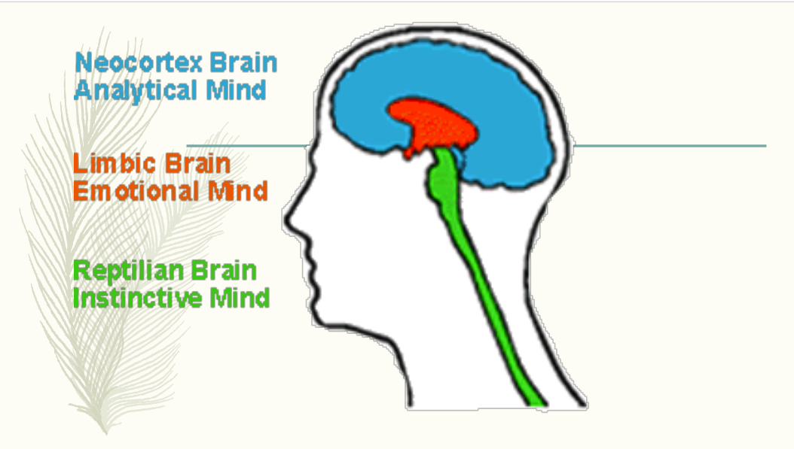
How does stress affect the brain?
“Upstairs” for
thinking
“Downstairs” for
emotions
Courtesy of James Soward
Notes:
One thing that can help is to understand that there is a biological basis to what we are experiencing when we are stressed, because that understanding can help us to manage our own stress and respond more compassionately when our children are stressed
When someone is stressed, the “upstairs” or thinking brain (which is in the prefrontal cortex) literally stops working. The thinking brain is in charge of rational thinking, planning, organizing, problem solving, and prioritizing where to place attention
When the thinking brain is offline, the “downstairs” or emotional brain takes over. The emotional brain is in charge of responses to perceived threats and may cause us to fight, flight, or freeze responses in order to survive.

Slide 9
Stressors can activate stress response
Notes:
A stressor is something that can activate the stress response
When we’re stressed, not only is there a disconnect between the thinking and feeling parts of our brain, but there is also an activation of the sympathetic nervous system which affects our entire body down to our blood cells and immune system
If the stress response is activated briefly, such as when you need to run away from a tiger, that can save your life
But if the stress responses is activated repeatedly, day after day after day, that can wear away at both mind and body

Slide 10
Adverse Childhood Experiences (ACEs)
Family-Level Risk Factors
Notes:
This is what can happen with ACEs
The ACE study defined ACEs as experiences of child abuse and neglect or household dysfunction that occurred prior to the age of 18. Child abuse included physical, emotional or sexual abuse. Neglect included physical and emotional. Household dysfunction included mental illness, domestic violence, divorce or separation of parents, incarceration and substance abuse.
Notice that all of these experiences directly affect the home environment and parent-child relationships so can be called family-level risk factors.
Many people, in fact, most people (65%) have experienced one or more ACEs

Slide 11
ACEs Increase Risk
Over time and without protective factors, ACEs can result in health problems, school problems, and other challenges
Increased risk of mental health problems like depression, alcoholism and drug abuse
Increased risk of medical problems like heart disease, cancer and obesity
Increase risk of social problems like school failure, being arrested, and being homeless
The more ACEs someone experienced, the higher the risk of these problems
Center on the Developing Child, Harvard University
Notes:
Over time and without protective factors, ACEs can result in health problems, school problems, and other challenges
For example, ACEs increase risk of mental health problems like depression, alcoholism and drug abuse
ACEs also increase risk of medical problems like heart disease, cancer and obesity
And ACEs increase risk of social problems like school failure, being arrested, and being homeless
The more ACEs someone experienced, the higher the risk of these problems
Note- based upon studies of groups that compared group means

Slide 12
What do these problems have in common?
Failure to thrive
Speech/other delays
Autism
ADHD
Temper tantrums
Depression or Anxiety
Insomnia
Being bullied
School problems
Obesity
Constipation
Enuresis
Headaches
Hypertension
Injuries
Severe asthma
STDs
Substance abuse
Notes:
These are common problems seen in pediatric practice
What do they have in common? ACEs increase the likelihood of all of these problems
If you don’t ask about ACEs, you may not know about the influence of ACEs on these problems, and so you may miss an opportunity to address psychosocial factors that matter

Slide 13
What Happens at Home Matters
Unsafe
Unstable
Unsupportive
Safe
Stable
Nurturing
Notes:
The research on ACEs tells us that what happens at home matters for child health and development, as well as future adult health
The critical question is- what type of relationships does this child have at home- Safe Stable Nurturing or Unsafe Unstable Unsupportive

Slide 14
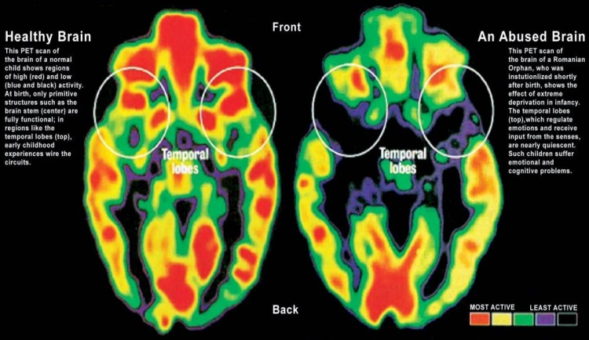
The Brain Develops at Home
Schofield et al, 2013; Source: Dr. Harry Chugani M.D., Chief, Division of Pediatric Neurology, Director, Positron Emission Tomography(PET) Center, Children's Hospital of Michigan
Notes:
This slide dramatically illustrates the potential influence of ACEs on our biology
The picture on the left shows that the first 2 years of life are critical to developing synapses in the brain, connections that are critical to our ability to understand and respond to the world
On the right are PET scans of two 2-year old children. The child on the left came from a safe, stable and nurturing home environment. The child on the right was maltreated and brought to a Romainian orphanage

Slide 15
Children age 5-11 years with higher parent-reported ACE scores had higher inflammatory cell gene expression
and higher Type I interferon expression
Notes:
We also showed in our research that the influence of ACEs on the stress response is not just theoretical, but actually measurable
The group of children with higher parent-reported ACE scores also had higher activation of the immune system

Slide 16
Stressor
Protective Factor
Stress
Response
+
=
e.g. immunization,
first day at school
Positive
Brief
Response
sufficient
perceived resources
Serious
Temporary
Response
e.g. loss of loved one,
earthquake or fire
sufficient
Tolerable
perceived resources
Severe e.g. rape
Chronic e.g. racism
Traumatic e.g. ACEs
Prolonged Activation
Leading to
Health Problems
insufficient
Toxic
perceived resources
Notes:
But remember, I said at the beginning adversity is not destiny
The type of stress response that occurs depends not only on the type of stressor, but also on the presence or absence of resources like protective relationships
In other words, chronic stress and trauma do not have to result in poor outcomes. Friends and family members, health care professionals and other professionals in human service roles, all have opportunities to prevent the negative effects of adversity

Slide 17
Summary- The Science of ACEs
The biology of ACEs is the biology of stress
Higher ACEs are associated with higher risk of health problems, school problems, and social problems
Whether ACEs result in health problems depends upon the presence or absence of sufficient protective factors
What We Don’t Know about ACEs
How do we measure ACEs in children?
How often should we measure ACEs?
How does context affect measurement?
What does an ACE score by itself tell us about an individual?

Slide 18
What builds resilience
Resilience

Slide 19
CASE “Alice”
6yo female who is brought in by her mother for a pediatric well-child visit
Lives with her single mother and 1yo brother. Occasional visits with her biological father
Mother reports that Alice has frequent temper tantrums and will listen to everyone else but her mom. Alice also has trouble falling asleep and is always trying to stay up later
In reviewing the Whole Child Assessment, you note that mother reports a history of depression and has some current symptoms of depression and anxiety.
Mother interrupts history several times to reprimand Alice for not sitting still and for trying to lie on her lap. “She’s so clingy I can’t stand it,” she says to you. And later she says to Alice, “You’re such a pain.”
Mother would like Alice to get Behavioral Health treatment.
Are there ACEs?
What can you do or say to help Alice and her mother?
Notes:
Let’s start with a case
Are there ACEs? Yes- single parent, possible maternal mental health problems, verbal abuse/hostile relationship
What will help? Will discuss next

Slide 20
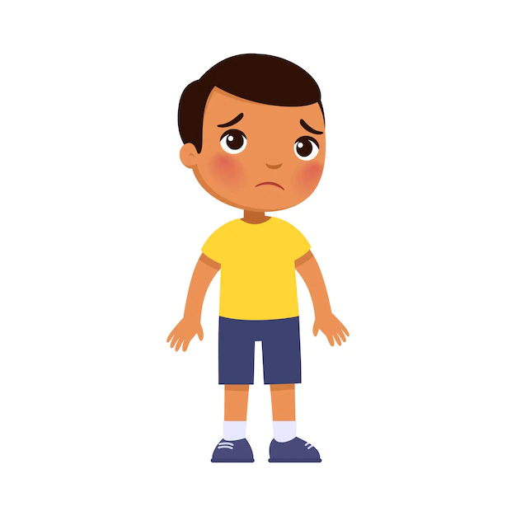
Shift in Perspective
Biomedical perspective focusing on the pediatric patient only
Biopsychosocial perspective considers the pediatric patient in the context of relationships
What is wrong with you?
Blaming
Punishment
What happened/is happening to you?
Understanding, empathy
Helping, promoting strengths
Notes:
The key to understanding resilience is learning to shift our perspective
In a biomedical model of pediatrics, we focus on the child and come up with a differential diagnosis of what’s wrong with the child
This is also how Alice’s mother is thinking. Alice misbehaves and her mother thinks there is something wrong with Alice and that she needs to discipline her
But when we recognize the importance of relationships on health and well-being, we shift our thinking from blaming people for things that may have been out of their control, to understanding what was influencing them.
This shift in thinking helps to promote understanding which leads to us to feeling empathy and acting compassionately
This shift in thinking also focuses us on ways to help and promote strengths
MIND BLOWN- Think about Jacob- what if throughout our system there was a shift in perspective…would we have found a way to help him heal from his early life trauma rather than adding to the trauma

Slide 21
The Science of Resilience
Protective Factors
Meeting basic family needs, starting with safety
Supporting resilience for caregivers, starting with self-care
Creating stable and nurturing relationships so children form secure attachments to their caregivers
Learning about parenting and social-emotional development
Building social connections for the whole family
In bold, aka “Positive Childhood Experiences”
Center on the Developing Child, Harvard University
Brown, 2014
Notes:
What helps in general is not a mystery. There is a robust literature on what promotes resilience in individuals
Protectives factors that help overcome adversity and support resilience include meeting basic family needs starting with safety, supporting resilience for caregivers starting with self-care, creating stable and nurturing relationships so children form secure attachments to their caregivers, learning about parenting and social-emotional development, and last but not least, building social connections for the whole family
Overlap with PCEs in bold – growing literature on this topic, mostly in adults to date, but is not surprising that measuring protective factors helps with prediction
Let’s talk about these 5 protective factors in a little more detail

Slide 22
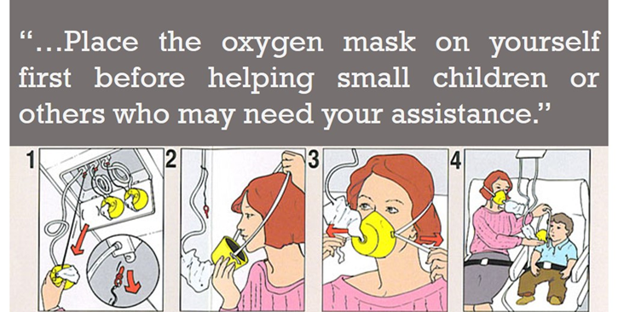
1. Support Resilient Caregivers
Caregivers who take care of themselves and lead a healthy lifestyle
Caregiver self-care includes monitoring and regulating stress
This is especially important because children have strong mirror neurons, meaning their brains are constantly noticing how caregivers feel and reciprocating that feeling
Notes:
One of the most important things you can say to parents such as Alice’s mom, who are often busy putting everyone else’s needs ahead of their own, is that their own self-care matters
Parent self-care also includes monitoring and regulating your own stress.
This is especially important because children have strong mirror neurons, meaning their brains are constantly noticing how you feel and reciprocating that feeling. If you are feeling angry they feel angry, if you are feeling sad they feel sad, and so on.
So taking care of yourself is key to healthy parenting

Slide 23
2. Meet basic needs, starting with safety
Physical space
Injury prevention
Psychological space
Voice and choice
Discipline without fear
Predictable routines
Eating, exercising, playing, sleeping
*** especially when there is a history of trauma
Establish predictability
Build trust
Reduce anxiety
Notes:
Creating a safe place for children to grow and thrive starts with physical safety, like taking precautions to prevent injuries, but is about more than physical safety.
We also want to create spaces that are psychologically or emotionally safe for children, meaning that they feel like they can say what they are thinking or feeling, that they have choices, and that they can learn from their mistakes without being afraid of the consequences.
A sense of safety is also created by establishing predictable routines

Slide 24
3. Create stable and nurturing relationships
Healthy Relationships
Trauma Treatment
Parent-Child Interaction Therapy (PCIT)
Child-Parent Psychotherapy (CPP)
Attachment and Biobehavioral Catch-up (ABC)
Trauma-Focused Cognitive Behavior Therapy (TF-CBT)
Nat’l Child Traumatic Stress Network
Create Safe Places
Listen
Show Love
Play
Understanding Human Development
Notes:
Third protective factor is creating safe, stable and nurturing relationships
All of the evidence-based parenting curriculums that have been shown to improve child behavior and long-term outcomes focus on these key foundations to building healthy relationships
Sometimes this will mean helping a biological parent learn to support their child
Other times it will mean helping that child to find other sources of support, such as from a grandparent, foster parent, or teacher
When you see dysfunctional relationships, such as in the case of Alice and her mother, the few words and resources that you can give at a pediatric visit are not enough
Question is whether you can convince Alice’s mother of importance of seeking mental health support

Slide 25
4. Learning about parenting and social-emotional development
Incredible Years
Triple P Positive Parenting
Nurturing Parenting Programs
Nurse-Family Partnership
Parents as Teachers
Parenting Wisely
Strengthening Families
…
Notes:
Or to participate in a family class like one of the ones shown here
There are also self-help resources like website and book
But participation in family class is ideal
But like smoking cessation- more someone hears recommendation to quit

Slide 26
5. Build social connections
Spending time with extended family, friends and/or neighbors helps children develop social connections who become resources in their lives
Also reduces stress for primary caregivers
Notes:
Last but not least, building social connections
Social isolation is most common deficit that I see in families with ACEs
Encouraging caregiver and child to prioritize connecting to a community is important- if not family then through school, sports, arts, spiritual

Slide 27
Summary- The Science of ACEs & Resilience
The biology of ACEs is the biology of stress
Higher ACEs are associated with higher risk of health problems, school problems, and social problems
Whether ACEs result in health problems depends upon the presence or absence of sufficient protective factors
Adversity is not destiny
Protective factors reduce ACEs and their impact:
Meeting basic needs including safety
Supporting caregiver self-care
Encouraging nurturing parenting
Learning about child development
Building social connections

Slide 28
FROM SCIENCE TO PRACTICE
Notes:
A lot know about ACEs and Resilience, but how translate into practice

Slide 29
Can Knowledge about ACEs be Translated into Prevention through Pediatric Practice?
“What is predictive is preventable”- R. Anda
Notes:
In the story of my life, started with my internship. Patient who preferred to sit on my knee rather than mother’s
(animation) read the ACE study thought occurred to me, can we prevent poor outcomes?
(animation) first research paper on topic

Slide 30
Analytic Framework:
Screening for ACEs in Childhood (C-ACEs)
Screening
for ACEs
Intervention to
build Resilience
Asymptomatic
Pediatric Patients
Toxic
Stress
Child and Adult Health Outcomes
Harms
Harms
Based upon methods used by the USPSTF,
https://www.uspreventiveservicestaskforce.org/uspstf/
Notes:
This is what the USPSTF calls an analytic framework, and it’s used to evaluate whether there is sufficient evidence for screening in clinical practice
Now note what we are screening for. Goal is not to identify ACEs, but to identify toxic stress.
Growing literature that higher ACE scores associated with biomarkers of toxic stress, our recent study. But how best to measure “toxic stress” is a research topic. Put that important question aside
The basic questions to examine the evidence behind screening are:
Do we have valid tools for screening?
Do we have interventions that will help improve child health outcomes, and ultimately adult health outcomes? and
Are there any harms associated with screening or intervening?

Slide 31
Validation of a Screening Tool Can target be identified accurately?
Face validity
Construct validity
Criterion validity
Concurrent validity
Predictive validity
Measures: need a gold standard
Sensitivity and Specificity
Predictive values
Validate tool
Validate use of tool for
individuals
Notes:
There’s more than one way to assess the validity of a tool, and the more evidence for validity the better.
Face validity- experts agree represents what supposed to represent- weakest evidence for validity but an important starting point
Construct validity- e.g. depression- not sure how do for ACEs since multifactorial, or toxic stress since no gold standard
Alternatively you could look at criterion validity (whether test reflects expected outcomes, in the case of ACEs health problems): a) Concurrent- cross-sectional correlations; b) Predictive- associations with future outcomes- this is what ACE study did and what we have done in our research
But to validate the use of the tool on individuals, meaning you can tell them this is what this result means for them, need measures of sensitivity, specificity and predictive values, but to calculate these you need a gold standard. What’s the gold standard for toxic stress?
If use ACE score in practice, need this kind of evidence that the ACE score is an accurate measure of toxic stress
So what know about measures of ACEs that can be used in pediatric practice? Let’s look at three examples

Slide 32
Safe Environment for Every Kid (SEEK) https://seekwellbeing.org/seek-references/
Tool designed to prevent child maltreatment
16 yes/no questions (~5 minutes)
Validity
Efficacy
↓ CPS reports
↓ harsh punishment
↓ maternal psychological aggression
 | Sens | Spec | PPV | NPV
Depression | 74% | 80% | 36% | 95%
Substance | 29% | 95% | 17% | 98%
IPV | 29% | 92% | 41% | 88%
Notes:
The SEEK tool does not contain all ten ACEs but does contain key questions about parent depression, substance use and violence
Have measures of sensitivity and specificity. Sensitivity not great for substance use and violence, better than not screening
Also have evidence intervention-handouts with resources and social worker- can improve child outcomes

Slide 33
Whole Child Assessment (WCA) https://lluch.org/health-professionals/whole-child-assessment-wca
Tool designed as alternative IHEBA with ACEs (replaces SHA)
Paper and electronic versions for all well-child age groups
12-15 questions about adversity/ACEs included in questionnaires with total 32-50 questions (~10-15 minutes to complete)
Validity
Face validity, Concurrent validity (including biomarkers), Predictive validity
Efficacy?
clinical trial
in progress
Notes:
The SEEK tool was actually one of the references used in designing the WCA. This tool was developed by myself and colleagues at LLU because we wanted to add screening for ACEs to our well-child visits, but it was cumbersome to do this plus the SHA required for California providers plus all of the other tools we were using at well-child visits. So we created one questionnaire to use which is an approved alternative IHEBA, meaning that California providers can use this instead of the SHA.
We have demonstrated face validity as well as feasibility, meaning that we have shown that it can be used to screen for ACEs during routine well-child care.
We have also demonstrated concurrent validity with both child health and psychosocial outcomes, as well as child biomarkers. And recent report on predictive validity
Efficacy- not just based on tool but how use tool- clinical trial in progress

Slide 34
Whole Child Assessment (WCA) https://lluch.org/health-professionals/whole-child-assessment-wca
Can replace Staying Healthy Assessment and be integral to well-child workflow
Intended as an interview guide rather than a stand-alone survey, which if used this way can facilitate accurate understanding of ACEs plus
Includes questions about risk to optimize opportunity to prevent ACEs
Includes questions about mental health symptoms to assess current impact of ACEs
Facilitates prioritization of topics to maximize efficiency
Interval history -> Safety -> Substances -> Mental health -> Relationships -> …
Incorporates diet, exercise, sleep questions which are key to counseling to reduce stress
Gives specific info for providers to respond to
Includes measures of “social determinants of health”
Does calculate ACE score if wanting to know ACE score
Notes:
Because this is the tool that we use in our practice, I want you to know some of its advantages. Note however that I have no financial investment in whether you use this tool. It is intentionally freely available to the public because we did not want cost to be a barrier to use

Slide 35
PEARLS
Tool focused on exposure to adversity, including additional social determinants
17-19 yes/no questions (~5-10 minutes)
Validity
Face validity
In progress- “construct validity”
Efficacy?
Notes:
Third tool that I am obligated to mention because of current California policy is the PEARLS
This is one and only tool can use to get reimbursed, despite fact that has least amount of evidence for validity
What does have is simplicity- can count yes/no responses and get an ACE score

Slide 36
Problems with ACE score as basis for diagnosis
Case 1: 15 year old overweight female with depression since age 10 and cutting
What’s her ACE score?
Case 2: 15 year old healthy weight male with no health problems and doing well in school
What’s his ACE score?
ACE score by itself is missing info about protective factors
ACEs
Resilience
Notes:
If we stay stuck in a biomedical model, we may think of ACE screening in the same way that we screen for tuberculosis or some other infectious disease. We may pick a screening tool that easily gives an ACE score and focus our workflow on the specific cutoff that triggers a referral to the nearest available behavioral health specialist. But that kind of reductionist approach completely misses the complexity of ACEs, as well as the opportunity to use information about ACEs and resilience to deliver primary care.
Let’s look at a couple of examples based upon real patients I’ve seen. Case 1… based upon her symptoms you might think that her ACE score was high, but actually her score was 1 (her parents were divorced at age 10)
Case 2 … based upon his lack of symptoms you might think that his ACE score was low, but actually his score was 6. If my workflow depended upon an ACE score cutoff of 4 or more, I might miss helping case 1 or misdirect resources in case 2.

Slide 37
Translating Knowledge about ACEs into Practice
Population-Level Research
Higher ACE scores associated with increased risk or poor health outcomes (difference in group means)
Public Health Practice
Monitor the prevalence of ACEs
Implement interventions to reduce ACEs including strategies to reduce community-level stress (e.g. poverty, violence, discrimination) and promote healthy families (e.g. home visiting programs, parenting interventions)
Individual-Level Research
What is the sensitivity, specificity and predictive value of an ACE score (for an individual)?
Unknown- need toxic stress gold standard
What is the sensitivity, specificity and predictive value of specific ACE questions?
More feasible to know, but is the goal in pediatric practice to accurately diagnose (e.g. maternal depression) or to improve ability to identify risky home environments?
Clinical Practice
What do do?
Notes:
Two “buckets” for translating knowledge about ACEs into practice
ACE research started on population-level
Translation to public health practice more straightforward then to clinical practice
Move from group to 1:1, Individual level research needed on validity of counting ACEs
Nonetheless, what I will show today, is that information about individual ACEs can be part of a BPS approach to good medical care
And that clinical practice offers an opportunity to focus on reducing family-level stress and promoting healthy relationships

Slide 38
What to do in clinical practice?
AB340 Advisory Group Recommendation (January 2019):
https://www.dhcs.ca.gov/Pages/AB340.aspx
Allow pediatric providers to use PEARLS, Whole Child Assessment (WCA), or any tool that includes the original 10 ACEs
ACEs Aware-UCAAN Policy (current):
Pediatric providers can only use the PEARLS to be reimbursed for ACEs screening
Providers must include a diagnosis of higher or low total ACE score to be reimbursed
My Recommendation:
Screen for specific ACEs using any tool that fits workflow
Use info about specific ACEs to counsel and refer
Advocate for change in ACEs Aware-UCAAN Policy to reflect current evidence
Contact https://cthc.ucsf.edu/ucaan/ or email Dr Thyne, sthyne@dhs.lacounty.gov and Dr Machtinger, Edward.machtinger@ucsf.edu
Notes:
“The problem of burnout will not be solved without addressing the issues of autonomy, competence, and relatedness.”
“Competency can be restored by purging the system of meaningless metrics while maintaining a core of evidence-based measures, allowing for clinical judgment, and honoring individual patient preferences.”
Not only example of government policy and insurance plans interfering with clinical practice, but is example I know best
Most important question- are we helping patients?

Slide 39
Analytic Framework:
Screening for ACEs in Childhood (C-ACEs)
Screening
for ACEs
Intervention to
build Resilience
Asymptomatic
Pediatric Patients
Toxic
Stress
Child and Adult Health Outcomes
Harms
Harms
Based upon methods used by the USPSTF,
https://www.uspreventiveservicestaskforce.org/uspstf/
Notes:
Need to know what physicians can do- mr yuk
Or mindfulness meditation- evidence that works in community but not question for clinical practice- will physician recommending make a difference
So important to look at do we have evidence of effective interventions

Slide 40
Ecological Model of Developing Child
Economic opportunity
Housing affordability
Educational quality
Discrimination
Violence
Poverty
Public Policy
Adverse Childhood Experiences (ACEs)
Relationships
Community
Neighborhoods, Businesses,
Public health
Social Determinants of Health
Emotional neglect
Emotional abuse
Physical neglect
Physical abuse
Sexual abuse
Incarceration
Mental illness
Substance abuse
Domestic violence
Divorce/separation
Organizations
Health care, Child care, Schools,
Social services, Law enforcement
Family-Level Risk Factors
Parent-Child
Attachment
Community
Resources
Child
Genetics
Neurobiology
Skills
Historical Trauma
Marie-Mitchell, 2020
Notes:
To evaluate what interventions are effective, need to clearly understand what problem addressing
Notice that ACEs as defined by the original ACE study is about family-level risk factors, which is different than community-level risk factors, like poverty and discrimination. Without a doubt, there is a relationship between community-level and family-level risk factors. When you add more community-level stressors on families, you increase the risk of ACEs. But the distinction between community-level and family-level risk factors matters to figuring out what type of interventions may be effective.
ACEs are about disruptions to parent-child attachment, so interventions must directly or indirectly support healthy relationships in order to build resilience.
Also ACEs at all SES

Slide 41
The Other Wes Moore
Wes 1
Father alcoholic
Father abusive
Parents separated
Mother marijuana use
Wes 2
Father died
Mother’s prior husband was abusive
Mother worked a lot
+ Military school
Notes:
This distinction is nicely highlighted in a book called The Other Wes Moore. In this book the author describes two boys both named “Wes Moore,” both African-American, both born and raised in a drug-ridden neighborhood in Baltimore.
Wes 1 grew up with a father who was alcoholic, abusive, parents were separated, mother used pot.
Wes 2 tragically lost his father at a young age, but he knew that his father loved him, there wasn’t abuse in his home, and when his mother saw him going down the wrong path she sent him to military school.
So which Wes wrote this book, and which Wes ended up in jail for murder?
The difference is ACEs

Slide 42
What Works for Poverty
Resource directories maintained in collaboration with local public health & community organizations e.g. United Way 211
Reach Out and Read
Healthy Steps for Young Children
Medical-Legal Partnership
Health Leads
Parent Mentors
Home visiting programs e.g. Nurse-Family Partnership, Early Start, Early Head Start
Fierman et al, 2016
Notes:
Several models have demonstrated that pediatric practices can help improve access to community resources and that can reduce the negative impact of poverty

Slide 43
What Works for ACEs
Primary Care Interventions
SEEK studies: combination of parenting education and community resources via handouts and social worker when needed; reduced CPS reports and psychological aggression
Community-Based Interventions
Home visiting programs
Parenting education
Social services
(Marie-Mitchell & Kostolansky, 2019; Seph et al, 2013; Flynn et al, 2015; Purewal et al,2018; Slopen et al, 2014)
Notes:
For evidence of what can be done in primary care, we really only have the SEEK studies
We do know that there are community-based interventions that are helpful for families with ACEs, and we can use that information to inform what we do in primary care
But that is not the same as having research that has shown that if a primary care physicians asks about ACEs and then does something to intervene, that that primary care physician can improve outcomes
How package and successfully deliver to families something our current research study examining

Slide 44
Summary- From Science to Practice
What Screening Tool
Limited evidence for the validity of any single tool to screen for ACEs in pediatric practice
Select a tool that fits your clinic workflow and helps you incorporate information about ACEs into patient care management
What Intervention(s)
Limited evidence to date that pediatric providers can prevent or reduce the impact of ACEs
Best evidence to date supports parenting education, connection to community resources, and use of home visiting programs
Monitor for Potential Harms

Slide 45
Building resilient families today
Notes:
Conclude with some guiding principles that can apply today
While research being done

Slide 46
There is No Excuse for Abuse
Safety & Stability
Cultural Humility
& Equity
Resilience & Recovery
Change
the
System
Compassion & Trust
Collaboration & Empowerment
Trauma Understanding
Adapted from Trauma Transformed
Notes:
trauma not ok at home- no spanking- no back talk- really?
then not ok at school- teachers need to listen, coaches yelling, work etc
TIS brief survey of staff re trust and safety
LISTEN

Slide 47
Safe Stable Nurturing Relationships
This Photo by Unknown Author is licensed under CC BY-NC-ND
Notes:
Maybe Reminder of Jacob- what if system were using

Slide 48
Focus on Relationships
Individual practice changes
e.g. at every patient encounter, find out who lives at home?
Clinic practice changes
e.g. prioritize continuity of care
Notes:
Who living at home- including stuffed animals- doesn’t always have a negative impact but always is impacting
Public clinic changing schedule

Slide 49
Build Healing Organizations
TRAUMA INDUCING TO TRAUMA REDUCING
Modified by Trauma Transformed from San Francisco Dept. of Public Health Trauma Informed Systems Initiative, 2017
Notes:
Big picture, courtesy of TT who are helping to disseminate work done by the SF DPH on creating TIS
What does a trauma-reactive organization feel like?...common but staff working within a trauma-reactive organization are not as effective in helping patients as they could be.
How do you transform your organization from one that is trauma-inducing to trauma-reducing
How can organization reduce stress for staff? E.g. scheduling, autonomy, paperwork burden
For patients? E.g. late policy, paperwork burden, continuity of care

Slide 50
Learn to Listen
Motivational Interviewing
A set of techniques that involve listening to other person’s perspective
In order to enhance motivation for positive behavior change
Notes:
Homework- motivational interviewing
How many listen?
Data on physician listening, some of you are lying
Important for all patients but especially ACEs with broken relationships

Slide 51
Look for Strengths in Others
Every patient and family has unique strengths
Praise strengths
Ask what would help
“All the world is full of suffering. It is also full of overcoming.”
- Helen Keller
Notes:
Always strengths e.g. Alice’s mother- brought her into clinic, got here, showing care
Partner with families- you don’t have to have all the answers and in fact won’t

Slide 52
Partner with the Community
Home visiting programs
Parenting classes
High quality childcare
Safe neighborhoods
Supportive schools
Structured extra-curriculars
Notes:
We work in sectors- health care, education, parks and recreation
But families live in communities and communities are critical to health
So as physicians promoting health, find ways to collaborate, advertise, connect

Slide 53
Summary- Building Resilient Families Today
Eliminate abuse from relationships in all settings
Use “safe, stable, nurturing relationships” to guide all policies and practices
Reduce stress/trauma at work to help build healing organizations
Learn to listen
Look for strengths in others
Partner with families
Partner with communities

Slide 54
Questions?
Ariane Marie-Mitchell
Email: amariemitchell@llu.edu
For more information about the Whole Child Assessment and related information:
https://lluch.org/health-professionals/whole-child-assessment-wca

Slide 55
SELECTED REFERENCES
Anda, R., L. Porter and D. Brown (2020). "Inside the Adverse Childhood Experience Score: Strengths, Limitations, and Misapplications." American Journal of Preventive Medicine 59(2): 293-295.
Browne C. The Strengthening Families Approach and Protective Factors Framework: Branching Out and Reaching Deeper. Washington, DC: Center for the Study of Social Policy;2014.
Dubowitz, H. (2014). "The Safe Environment for Every Kid model: promotion of children's health, development, and safety, and prevention of child neglect." Pediatr Ann 43(11): e271-277.
Fierman, A., et al. (2016). "Redesigning Health Care Practices to Address Childhood Poverty." Acad Pediatr 16(3): s136-s146. Finkelhor, D. (2017). "Screening for adverse childhood experiences (ACEs): Cautions and suggestions." Child Abuse & Neglect Aug 4.
Koita K, Long D, Hessler D, et al. Development and implementation of a pediatric adverse childhood experiences (ACEs) and other determinants of health questionnaire in the pediatric medical home: A pilot study. PloS one. 2018;13(12):e0208088.
Marie-Mitchell A, Kostolansky R. A Systematic Review of Trials to Improve Child Outcomes Associated With Adverse Childhood Experiences. American Journal of Preventive Medicine. 2019;56(5):756-764
Rollnick, S., W. Miller and C. Butler (2008). Motivational Interviewing in Health Care: Helping Patients Change Behavior New York, NY, Guilford Publications.
Sege, R. and C. Browne (2017). "Responding to ACEs With HOPE: Health Outcomes From Positive Experiences." Academic Pediatrics 17(7S): S79-S85.
Slopen N, McLaughlin KA, Shonkoff JP. Interventions to improve cortisol regulation in children: a systematic review. Pediatrics. 2014;133(2):312-326
Substance Abuse and Mental Health Services Administration (2015). SAMHSA’s Concept of Trauma and Guidance for a Trauma-Informed Approach.

