Slide 1
Building Harm reduction services in your community
Loris A. Mattox
Capacity Building Specialist
Harm Reduction Unit
Prevention Branch
Office of AIDS Division
California Department of Public Health
Loris.mattox@cdph.ca.gov

Slide 2
Harm Reduction Unit
Integrated public health goals: HIV, hepatitis C, overdose
Authorize, fund and grow syringe services programs
Technical assistance to help programs start, grow, and flourish
Public education
Policy work to expand harm reduction throughout California

Slide 3
WHAT HARM REDUCTION IS
Evidence-based and practical.
Incorporates a spectrum of strategies including safer use strategies, managed use, and abstinence.
Meets people “where they're at” but doesn't leave them there.
A philosophical and political movement.
Notes:
focused on shifting power and resources to people most vulnerable to structural violence

Slide 4
WHAT HARM REDUCTION DOES
Acknowledges the reality that drug use exists in all societies
Works with people while they continue to use drugs
Views the individual as a whole person
Any positive change is the goal
HIV Education and Prevention Project of Alameda County (HEPPAC)

Slide 5
What Harm Reduction Looks Like
Syringe
Access
Syringe
Disposal
Safer Drug Use
Naloxone
Medication Assisted Treatment
Supervised Consumption Services
Drop-In Centers
Housing
First
Pharmacy Access
Referrals

Slide 6
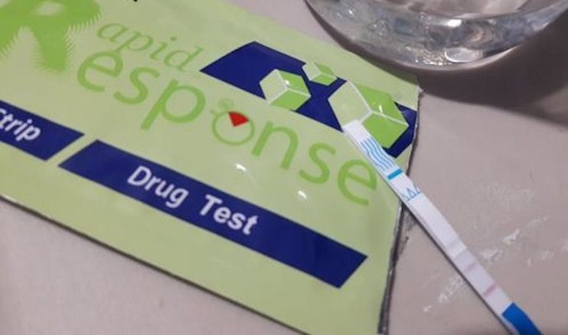
Fentanyl test strips distribution
They require precise dilution that is not realistic in most settings
High potential for producing false positives
They do not provide information about fentanyl concentration levels

Slide 7
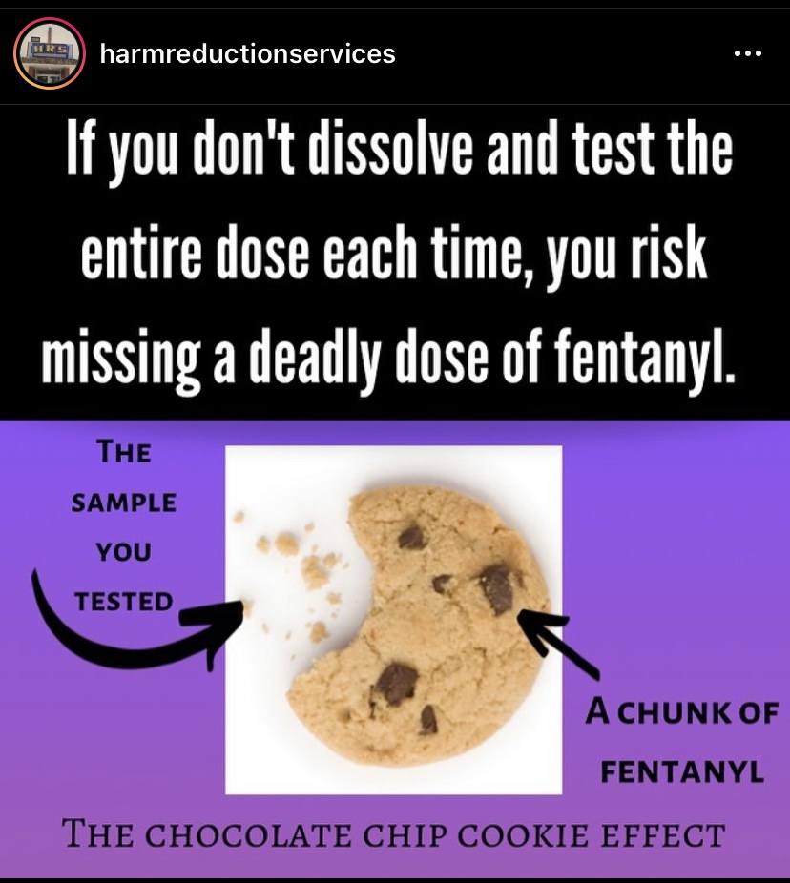
Fentanyl test strips distribution
They require precise dilution that is not realistic in most settings
High potential for producing false positives
They do not provide information about fentanyl concentration levels
Harm Reduction Services – Sacramento, CA

Slide 8
Fentanyl test strips distribution
START SLOW
USE WITH PEOPLE AROUND
HAVE NALOXONE
“Test and do not forgo other safety measures because of test strip results.”
Harm Reduction Services – Sacramento, CA

Slide 9
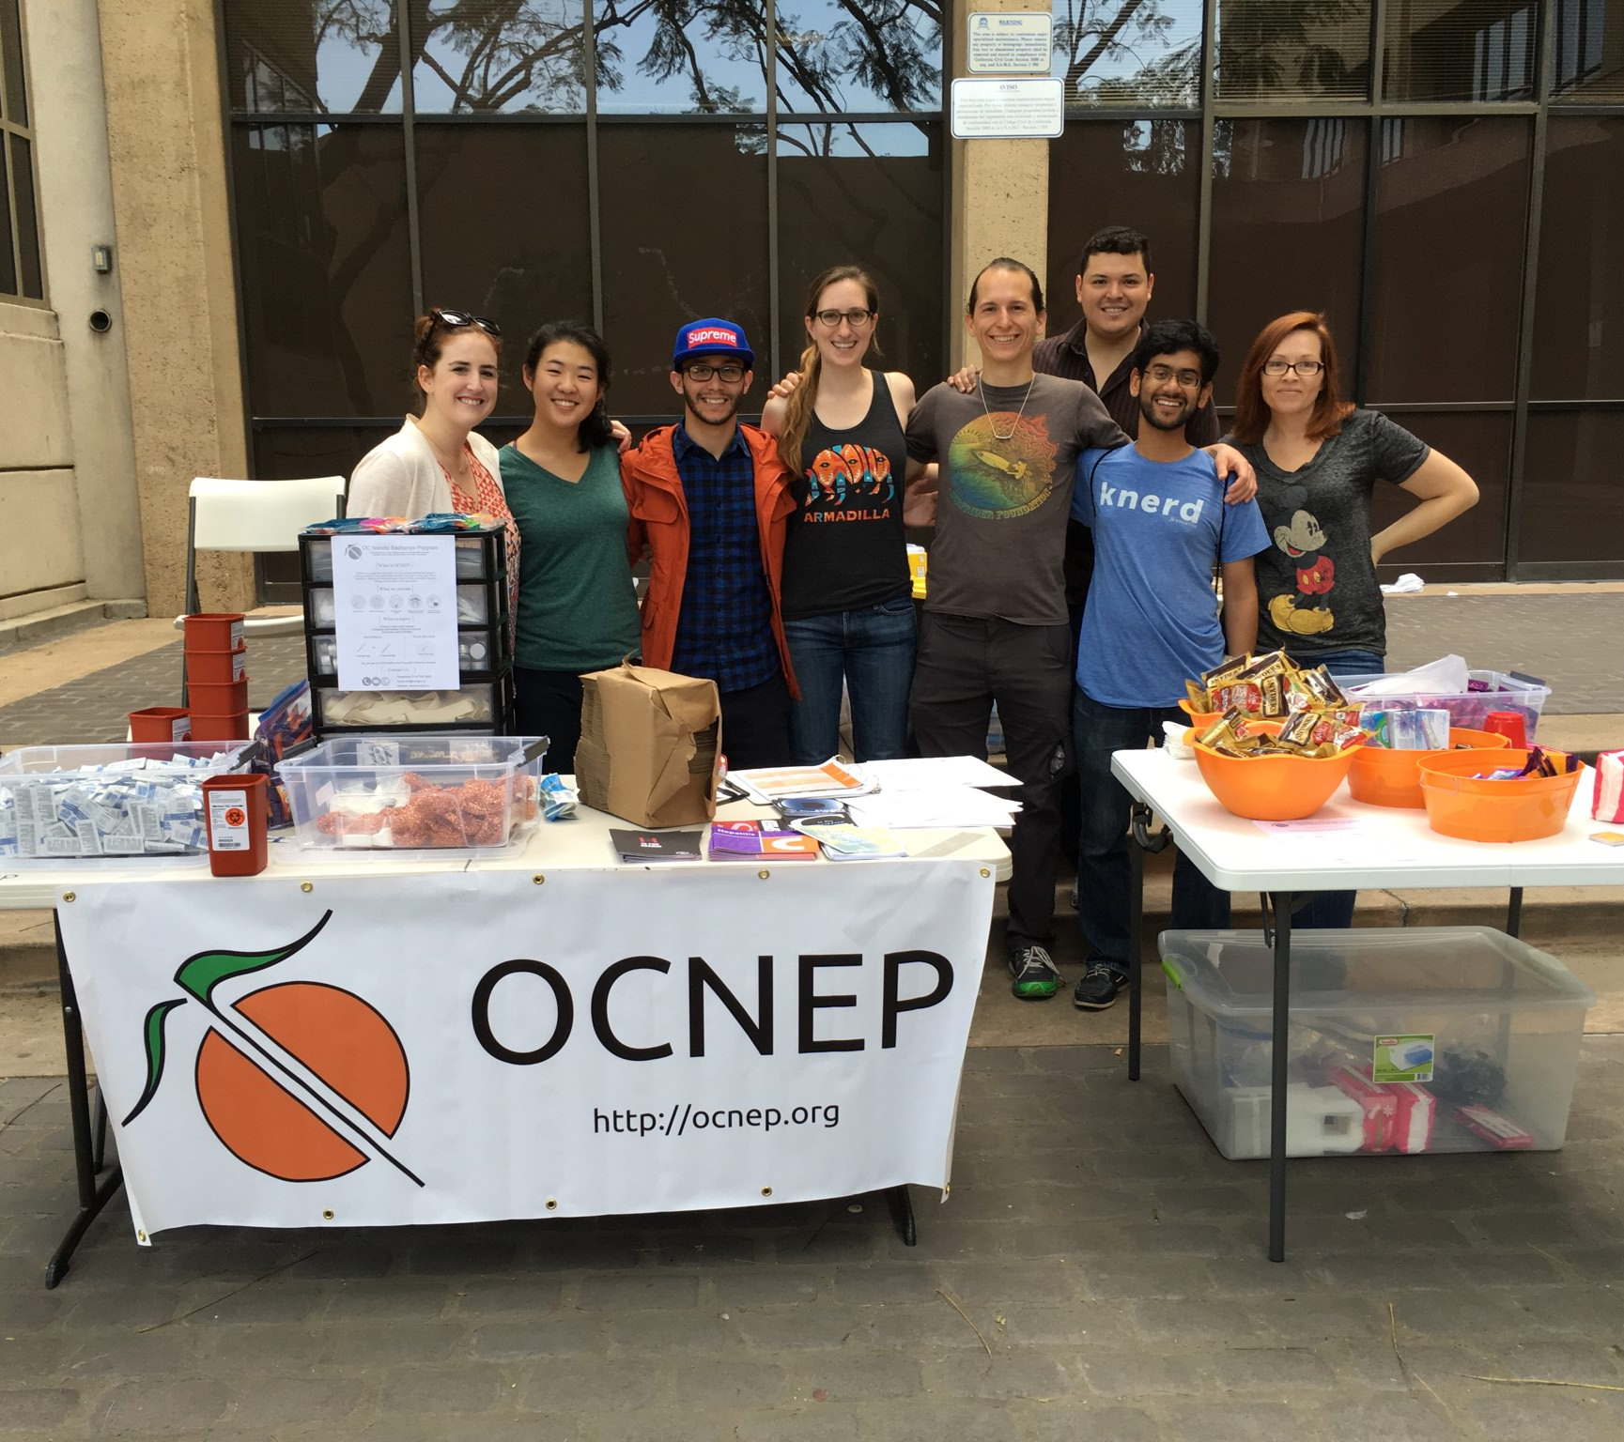
Harm Reduction in California
1980s: First syringe services programs (SSPs) founded in response to HIV epidemic
TODAY: 63 SSPs in 32 counties, including a statewide remote/mail-order program
State government has repeatedly acted to increase funding and reduce barriers to starting new SSPs
New programs providing low-barrier MOUD, naloxone, syringe access through emergency departments and via SSP-medical integration
California funded nearly half a million naloxone kits in 2021 through the DHCS Naloxone Distribution Project.
Orange County Needle Exchange Program

Slide 10
Harm reduction policy in California
Health and Safety Code 121349 states that SSPs may be authorized by CDPH or a city or county government, pursuant to California.
Business and Professions Code 4145.5(b) states that physicians and pharmacists may dispense an unlimited number of syringes without a prescription to anyone age 18 or older for disease and injury prevention purposes.
B&P Code Section 4145.5 permits the nonprescription sale of syringes by California pharmacies. A pharmacy that furnishes nonprescription syringes must store them so that they are only available to authorized personnel and are not accessible to other persons.
HSC Section 121349.1 states that SSP “participants shall not be subject to criminal prosecution for possession of syringes and any materials deemed by a local or state health department to be necessary to prevent the spread of communicable diseases, or to prevent drug overdose, injury, or disability acquired from an authorized needle and syringe exchange project entity.” It does not specify an age requirement. An authorized SSP may provide syringes to anyone, regardless of age, as part of services to prevent HIV and hepatitis C.

Slide 11
Harm Reduction Works Across Multiple Epidemics
Invasive Group A Strep
Wound Botulism
Other Infectious Diseases
Hepatitis A & B
Overdose
Deaths
HIV & HCV
STIs
incl congenital syphilis
Endocarditis
Skin & Soft Tissue Infections

Slide 12
HIV
Source: CDPH Office of AIDS

Slide 13
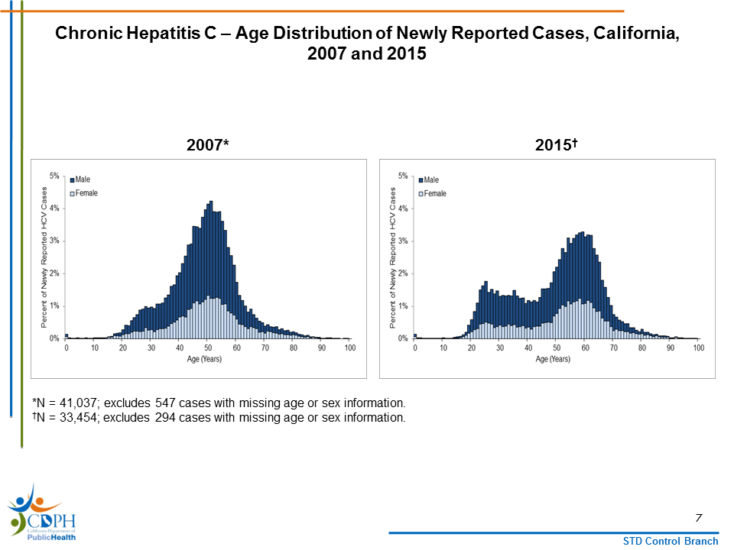
HCV
Newly Reported Cases by age distribution
California 2007 - 2015
Source: CDPH Office of Viral Hepatitis Prevention

Slide 14
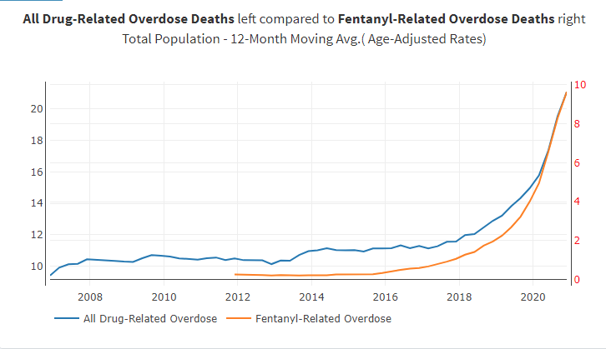
OVERDOSE DEATHS
Fentanyl-involved deaths increased 30x from 2015-2020
Source: CDPH Overdose Surveillance Dashboard

Slide 15
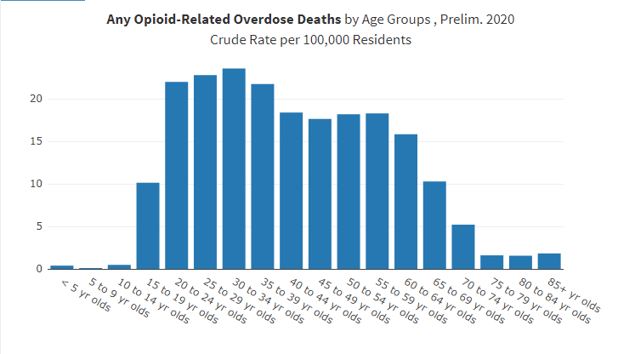
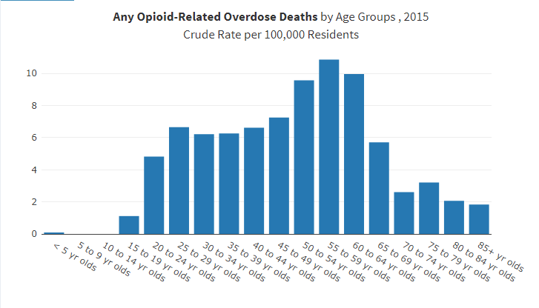
TREND: Teen overdose deaths spike
Age Distribution of Opioid Overdose Deaths, California 2015 and 2020
Source: CDPH Overdose Surveillance Dashboard

Slide 16
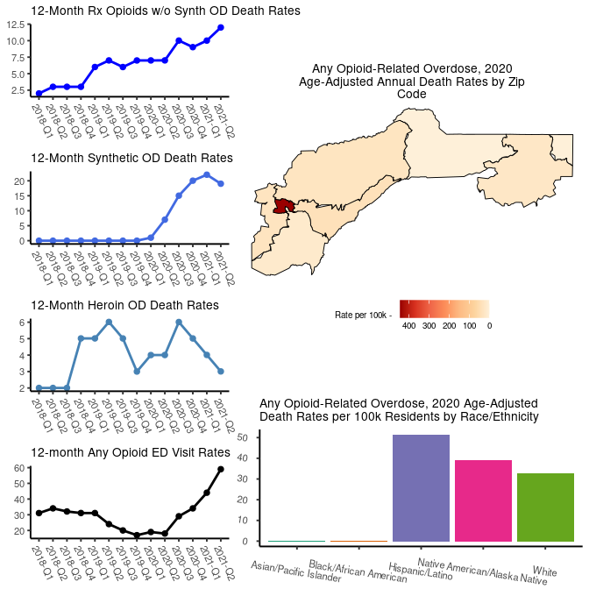
Nevada County Opioid Overdose Snapshot
2018-Q1 through 2021-Q2
Nevada experienced 30 any opioid-related overdose deaths in 2020, the most recent calendar year of data available and the annual crude mortality rate for 2020 was 30.06 per 100k residents.
*This represents a 328% increase from 2018*
Source: CDPH Overdose Surveillance Dashboard
Source: CDPH Overdose Surveillance Dashboard
Notes:
The map displays the annual zip code level age-adjusted rates for all opioid-related overdoses. Synthetic opioid overdose deaths may be largely represented by fentanyl
The following charts present 12-month moving averages for selected opioid indicators (prescription-, heroin-, and synthetic opioid-related overdose deaths, and ED visits related to any opioid) and include trend data for 2021*.

Slide 17
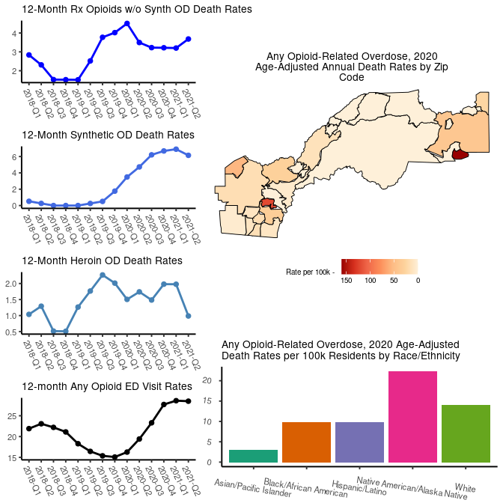
Placer County Opioid Overdose Snapshot
2018-Q1 through 2021-Q2
Placer experienced 45 any opioid-related overdose deaths in 2020, the most recent calendar year of data available and the annual crude mortality rate for 2020 was 11.13 per 100k residents.
This represents a 448% increase from 2018.
Source: CDPH Overdose Surveillance Dashboard
Notes:
The map displays the annual zip code level age-adjusted rates for all opioid-related overdoses. Synthetic opioid overdose deaths may be largely represented by fentanyl.
The following charts present 12-month moving averages for selected opioid indicators (prescription-, heroin-, and synthetic opioid-related overdose deaths, and ED visits related to any opioid) and include trend data for 2021*.

Slide 18
Turning to harm reduction
Identify and stop denial of services based on drug use
Educate staff on harm reduction concepts and practice
Create service linkages with local harm reduction providers
Support harm reduction groups in local policy
Adopt organizational policies that advance harm reduction
Offer harm reduction services yourself
Fill Gaps in naloxone access

Slide 19
considerations
Why do you think people object to
harm reduction services and concepts?
Can you identify one small action to promote or increase harm reduction services?

Slide 20
Resources
Background and other information from CDPH https://www.cdph.ca.gov/Programs/CID/DOA/Pages/OA_prev_sep.aspx
DHCS Naloxone Distribution Project https://www.dhcs.ca.gov/individuals/Pages/Naloxone_Distribution_Project.aspx
NEXT Distro: https://nextdistro.org/
CDC National Harm Reduction Technical Assistance Center: https://harmreductionhelp.cdc.gov/s/
National Harm Reduction Coalition: https://harmreduction.org/
CDC Syringe Services Programs information: https://www.cdc.gov/ssp/index.html
CDPH/OA Harm Reduction Unit: sspinfo@cdph.ca.gov

